Slide 1
Tool No. 6:
Forced Labour and the Sustainable Development Goals (SDGs)
Annotated slides (to be opened in Notes mode)
Notes:
Source: ILO: Toolkit for development and implementation of National Action Plans (NAPs) on Child Labour (Geneva, 2017).
Available at: www.ilo.org/ipec/Informationresources/WCMS_568877/lang--en/index.htm.

Slide 2
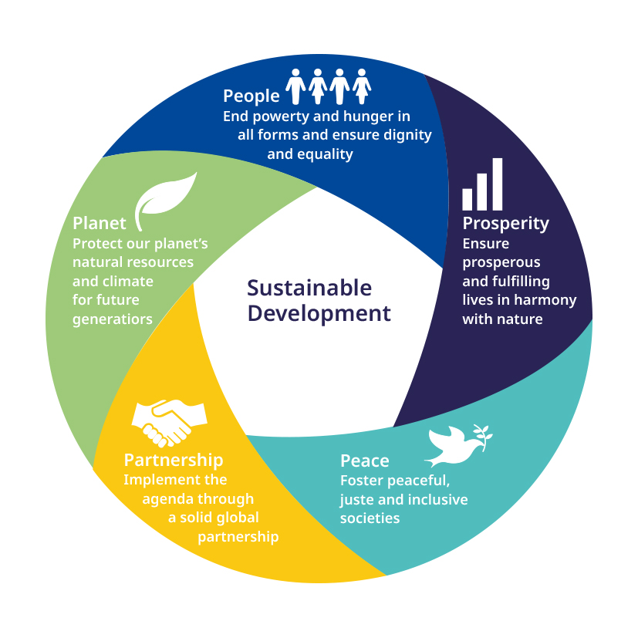

The SDGs basis
People, Planet, Prosperity, Peace
& Partnership
These 5 elements underpin the 17 Sustainable Development Goals, adopted by the UN General Assembly in September 2015.

Slide 3
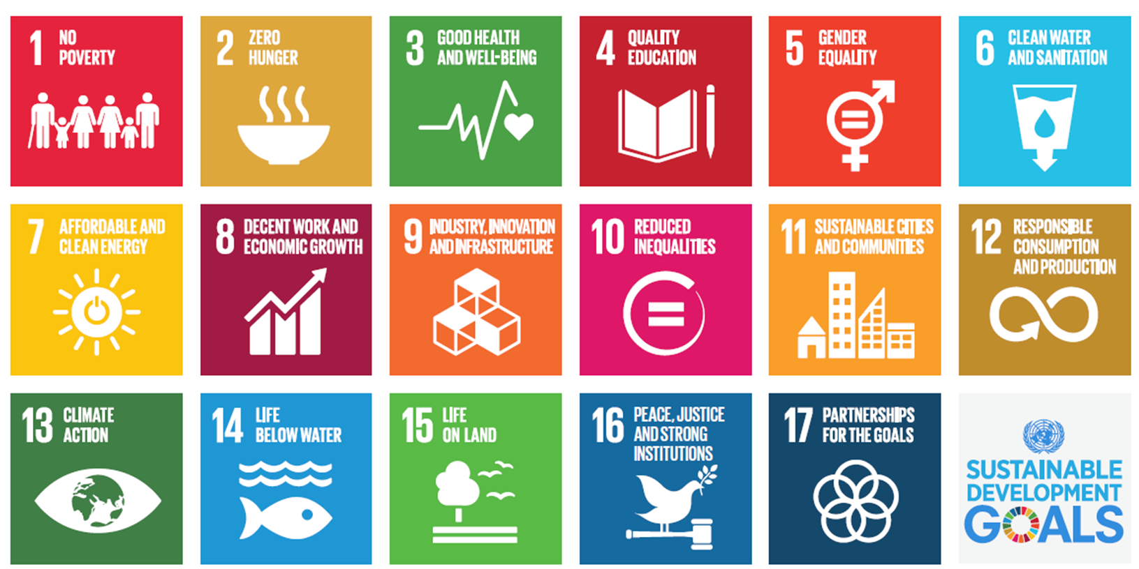
The eradication of forced labour is a specific target under the SDG 8.
However, the achievement of Target 8.7 is closely related to the achievement of other SDGs.

Slide 4
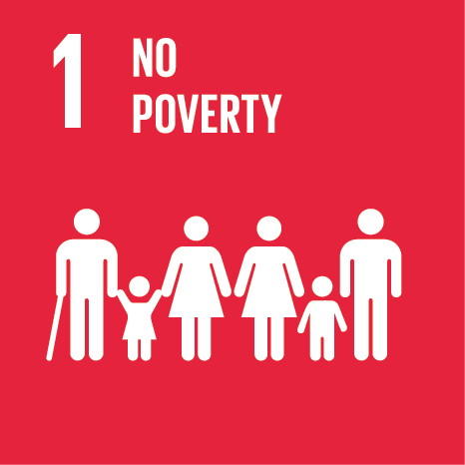
Poverty is one of the root causes of forced labour that in turn perpetuates inter-generational poverty.
Target 1.1 (eradication of extreme poverty) and target 1.2 (reduce by half poverty in all its dimensions) can only be achieved if forced labour is eradicated.
Target 1.3 (social protection) and target 1.4 (access to economic resources) are direct contributions to preventing forced labour.
Notes:
The links between poverty and forced labour are well established, reasonably obvious and often quite well known, so you may not need to spend large amounts of time on this. Sometimes partners are very clear that poverty causes forced labour, but less clear that forced labour perpetuates intergenerational poverty and that SDG 1 can therefore only be achieved if forced labour is eradicated – if so this should be explained.

Slide 5
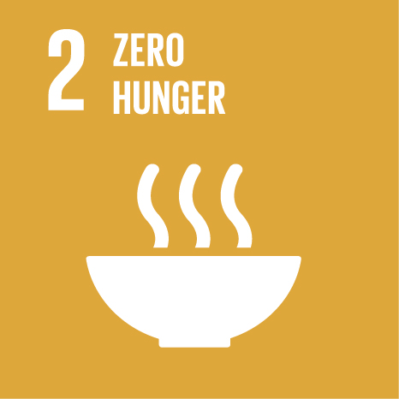
Target 2.1: By 2030, end hunger and ensure the access by all people, in particular the poor and people in vulnerable situations, including infants, to safe, nutritious and sufficient food all year round.
Food insecurity makes people vulnerable to exploitative practices like forced labour.

Slide 6

Target 3.8: Achieve universal health coverage, including financial risk protection, access to quality essential health-care services and access to safe, effective, quality and affordable medicines and vaccines for all.
The inability to access health care makes people more vulnerable to income shock, especially for vulnerable groups like irregular migrant workers and workers in the informal economy.
Forced labourers often work in unsafe and degrading working conditions.
Notes:
The inability to access health care makes people more vulnerable to income shock. Concretely it means that a family may have to incur debt to cover health expenses which can lead to debt bondage, a common situation of forced labour.

Slide 7
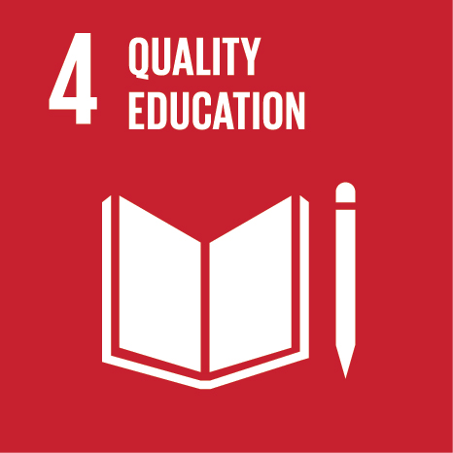
Ensuring education and training opportunities for young people and adults is an effective measure to prevent forced labour.
Vocational training is also instrumental in ensuring rehabilitation of victims of forced labour.
Notes:
This is a well established area that partners are often familiar with and hence you may be able to simply remind them of the ”vicious spiral” of poor education, poverty, child labour and forced labour that needs to be broken by making quality education and training accessible to ALL children (free and compulsory basic education is still a key response) and adults (training and education is a key alternative to, for example, unsafe migration that may result in forced labour). Vocational training is also instrumental in ensuring rehabilitation of victims of forced labour. Remember to stress gender dimensions that may be relevant in your context.

Slide 8
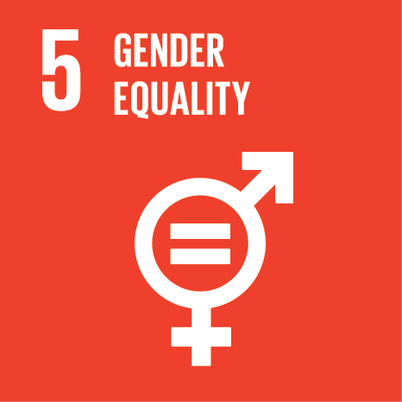
Target 5.1: End all forms of discrimination against all women and girls everywhere.
Target 5.2: Eliminate all forms of violence against all women and girls, including trafficking and sexual and other types of exploitation.
Target 5.4: Recognize and value unpaid care and domestic work.
Forced labour has a gender dimension: women represent over 62 per cent of the victims. Women and men tend to be affected within stereotypical gender roles (i.e. female in domestic work and male in manual sectors, such as fishing or construction).
Notes:
Forced labour has a gender dimension. Women are disproportionately affected: of the estimated 25 million victims of forced labour, women and girls represent 15.7 millions. In particular, they account for 99% of victims of forced sexual exploitation. However, men and boys can be overlooked as victims of forced labour, as they can be more reluctant or ashamed to ask for help.
Women and men tend to end up in forced labour situations that fit within stereotypical gender roles (i.e. female in domestic work and male in manual sectors, such as fishing or construction).
Regarding unpaid domestic work, women and girls bear an extra burden, in addition to their job/forced labour obligations or school work. Domestic work is often invisible and under (or not) reported in household and labour surveys and data.
Forced labour policies must be gender-responsive: for example, women should have the possibility to talk to a female law enforcement officer as they may be more comfortable talking to a woman; or do male victims of forced sexual exploitation have access to shelters?

Slide 9
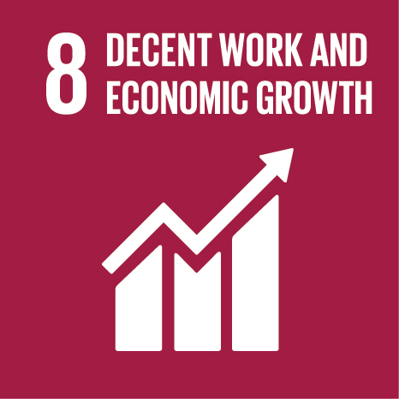
Target 8.7: Take immediate and effective measures to eradicate forced labour, end modern slavery and human trafficking and secure the prohibition and elimination of the worst forms of child labour, including recruitment and use of child soldiers, and by 2025 end child labour in all its forms.
Target 8.7 is the target for NAPs but other targets under Goal 8 must be kept in mind too.

Slide 10
Other relevant Targets under SDG 8
8.3: Promote policies that support productive activities, decent job creation
and entrepreneurship.
8.4: Endeavour to decouple economic growth from environmental degradation.
8.5: By 2030, achieve full and productive employment and decent work for
all women and men.
8.6: By 2020, substantially reduce the proportion of youth not in employment, education or training.
8.8: Protect labour rights and promote safe and secure working environments for
all workers, including migrant workers, in particular women migrants, and those in precarious employment.
8.10: Strengthen the capacity of domestic financial institutions to encourage and expand access to banking, insurance and financial services for all.
Notes:
All of these targets are crucially important to eradicate poverty and create decent work opportunities that will prevent forced labour, human trafficking and child labour.

Slide 11

Low productivity, scarce resources, limited innovation, may lead unscrupulous employers to use forced labour to increase profits. This, in turn, leads to unfair competition and can induce a “race to the bottom”.
The reputational risks associated with forced labour and child labour may also threaten the very existence of an industry or enterprise.
Notes:
A good example of the link between unsustainable environmental practices, unsustainable economics and the use of forced labour is a substantial part of the fishing industry in Asia, where overfishing and environmental degradation has caused economic pressure, leading to (possibly increased) use of forced labour on board fishing vessels. As vessels go further out to sea, spending more money on fuel etc., the use of forced labour has become a way to try to cut costs. This interplays with other factors (e.g. cultural traits and perceptions of fishing as undesirable work).

Slide 12
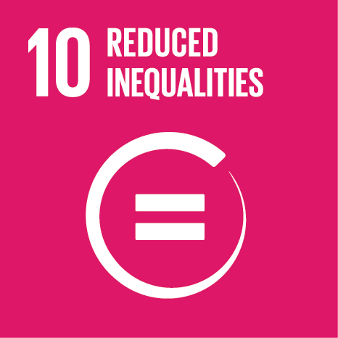
Children and adults from ethnic minorities, socially marginalised communities and discriminated groups such as migrants,
are at higher risk of forced labour.
In turn, forced labour and child labour reinforce patterns of extreme inequality.
Notes:
For more on equality and non-discrimination as a core right in relation to the eradication of forced labour, you can also take a look at Tool No. 1 and Annex 1 of the Guidance Manual (the glossary).

Slide 13
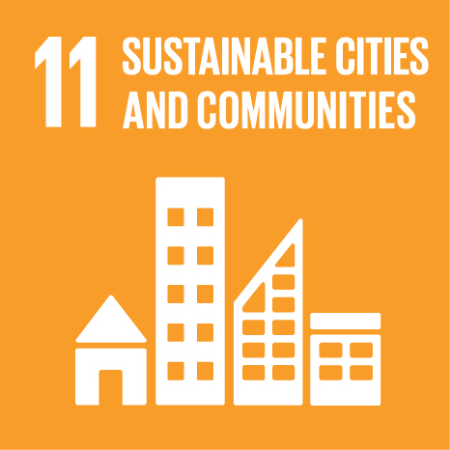
Target 11.1 By 2030, ensure access for all to adequate, safe and affordable housing and basic services and upgrade slums.
Safe, affordable housing and community services is an element of ensuring the family resilience that prevents forced labour.
Notes:
For example, debt bondage is widespread in brick kilns in Afghanistan. It is not uncommon for families to end up as bonded labourers when their house is destroyed in acts of war in the country. With nowhere else to go, families are “taken in” by brick kiln owners and must work in return for accommodation and food and to repay loans.

Slide 14
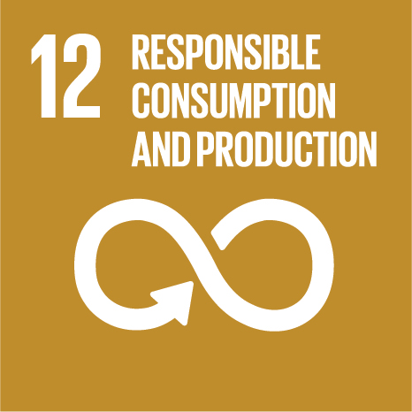
The ILO Forced Labour Protocol calls for countries to take measures to support due diligence by both the public and private sectors, in Article 2(e).
Unscrupulous businesses that use forced labour face an increasing risk of reputational damage, trade sanctions and, ultimately, economic losses.
It is important people question the way in which what they consume is produced, from both global and domestic supply chains, not only as related to environment protection but also whether workers were treated fairly.
See also Global Business Network on Forced Labour.
Notes:
There is growing international recognition that responsible business means eradicating forced labour (and other severe abuses of labour rights) from the entire supply chain. Businesses that use forced labour face an increasing risk of reputational damage, trade sanctions and, ultimately, economic losses. Global businesses are also integrating decent work standards in their supply chains, requiring their suppliers to abide by them or to face termination of contracts.
The ILO Forced Labour Protocol calls for countries to take measures to support due diligence by both the public and private sectors to prevent and respond to risks of forced or compulsory labour (Article 2(e)).
Useful links: UN Global Compact (www.unglobalcompact.org); UN Guiding Principles on Business and Huma Rights (www.ohchr.org/documents/publications/guidingprinciplesbusinesshr_en.pdf); Child Labour Platform (www.ilo.org/clp); and Global Business Network on Forced Labour (https://flbusiness.network/).

Slide 15

Climate change, natural disasters, food insecurity and the depletion of household resources make people more vulnerable to exploitation and forced labour.
Besides, forced labour may also be directly linked to environmental crimes: forced labour is widely used in deforestation,
as well as in illegal fishing.

Slide 16
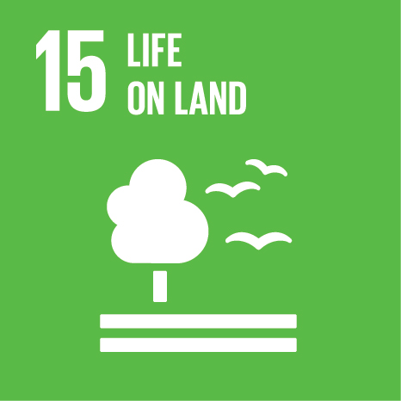

Deforestation, soil erosion and other (human-induced) depletions of natural resources threaten people’s livelihoods, making them vulnerable to forced labour.
The global fishing industry is illustrative of the links between preservation of natural resources and labour rights: overfishing has led to depletion of the stock and coastal fishermen can no longer sustain themselves. They become vulnerable to human trafficking and forced labour aboard large, industrial vessels in the global fishing industry.
Notes:
See for example: Lawrence, Booth: “Modern-day slavery: horrific conditions on board ships catching fish for Europe”, in The Guardian (2010). Available at: www.theguardian.com/law/2010/sep/30/modern-day-slavery-fishing-europe; or George: “The marine, and human, costs of illegal fishing”, in New Statesman (2016). Available at: www.newstatesman.com/culture/books/2016/02/marine-and-human-costs-illegal-fishing.

Slide 17

Target 16.1: Significantly reduce all forms of violence.
Target 16.2: End abuse, exploitation, trafficking and all forms of violence against and torture of children.
Target 16.3: Promote the rule of law at the national and international levels and ensure equal access to justice for all.
Target 16.4: By 2030, significantly reduce illicit financial and arms flows, strengthen the recovery and return of stolen assets and combat all forms of organized crime.
Target 16.5: Substantially reduce corruption and bribery
in all their forms.
People who flee conflict and violence are at extreme risk of falling prey to criminal networks behind human trafficking and forced labour. This has been documented extensively among refugee and migrants reaching Europe for example. Children are at increased risk of suffering violence and exploitation.
Corruption may facilitate perpetuation of illegal practices like human trafficking and forced labour (paying law enforcement to turn a blind eye, for example).
Notes:
Trafficking for forced labour exploitation is often directly linked with transnational, organized crime syndicates and therefore needs to be addressed under target 16.4.

Slide 18
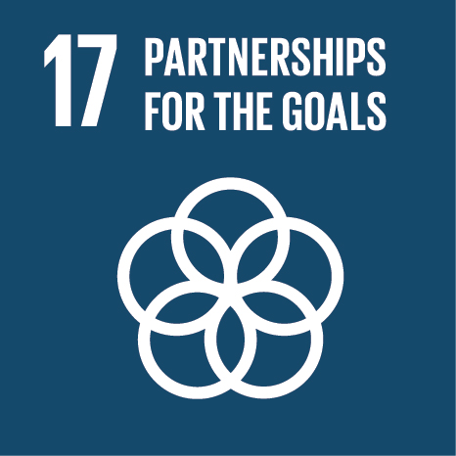
In a globalized world the persistence of forced labour and child labour anywhere is a problem everywhere!
It is particularly important in the case of migrant workers that countries of origin, transit and destination work together to prevent trafficking and promote fair recruitment.
Signing up to the SDGs requires commitment in action and allocation of resources by all countries.
Alliance 8.7 is the key global partnership on eliminating forced labour, human trafficking and modern slavery.
Notes:
For more information about the “4Ps” strategy, please refer to section 3 of the Guidance Manual.

